Slide 1


Slide 3
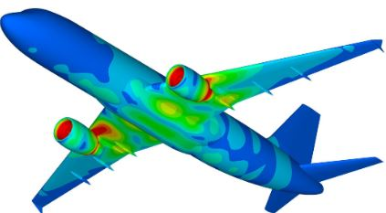
One
Two
Three
Four
Five

Slide 4

AUTO EXPO

Slide 5

EYE DROPPER
The event typically features the unveiling of new car and motorcycle models.
It also provides an opportunity for companies to interact with consumers, gather feedback, and gauge market trends.

